Slide 1

Advancements in CDN Load Balancing: The Journey from DNS to Modern Solutions
By Saber Mesgari
saber.mesgari@gmail.com

Slide 2

Load Balancing
Traffic Distribution
Load balancing is the process of distributing network traffic across multiple servers-datacenters to ensure no single server bears too much demand.
Improve Performance
By spreading the load, we can optimize resource utilization, maximize throughput, and minimize response time.
High Availability
Load balancing helps maintain service availability by redirecting traffic if a server goes down.

Slide 3

Why We Need Load Balancers
1
High Traffic Volumes
2
Multiple Servers - Datacenters
Lots of traffic from users necessitates distribution across multiple servers.
Lots of servers are needed to handle the traffic efficiently.
3
Geo-Distributed Services
4
Maintenance and Incidents
GEO based distributed services/servers require intelligent routing.
Our development team needs maintenance time for servers, and incidents can occur that require traffic redirection.

Slide 4
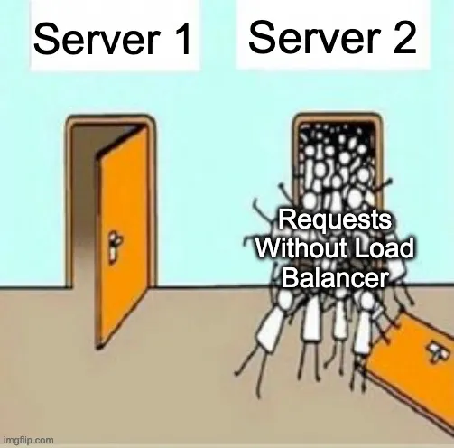
Load Balancing

Slide 5
The Need for Load Balancing Beyond Power
Physical Constraints
Avoiding Single Points of Failure
Even with an unbelievably powerful machine and a network that never fails, we still need load balancers.
We are limited by physical constraints associated with networking infrastructure, such as the speed of light, which creates an upper bound on how quickly we can serve data based on the distance it has to travel.
Even in an ideal world, relying on an infrastructure with a single point of failure is a bad idea. Load balancing helps distribute risk and improve reliability.

Slide 6

Optimal Traffic Distribution
1
Ideal Distribution
Ideally, traffic is distributed across multiple network links, datacenters, and machines in an optimal fashion.
2
CDN as a Optimal Load Balancer
In this presentation, we define the optimal load balancer as a CDN provider.
3
Modern CDN Features
CDN as a modern provider offers: Content Caching, DDoS Mitigation, Global Low Latency Network with 10+ Tb network capacity, and more.

Slide 7




Good Old Days
Early Servers
In the early days of the internet, single powerful servers handled most traffic.
Simple Networks
Network topologies were less complex, with fewer points of distribution.
Growing Demands
As internet usage grew, the need for more sophisticated load balancing became apparent.

Slide 8




First Idea: Dedicated Machines for Traffic Load Balancing
Concept
Implementation
Evolution
The initial approach to load balancing involved using dedicated machines specifically for distributing traffic.
These machines would sit between clients and servers, directing incoming requests to the appropriate backend servers.
This idea laid the groundwork for more advanced load balancing techniques in the future.

Slide 9
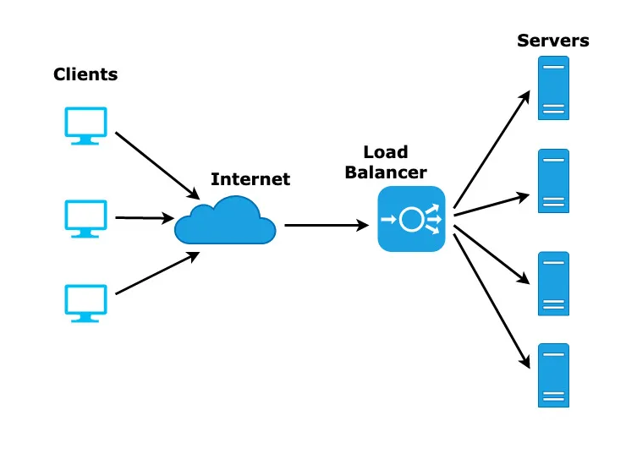
Dedicated Load Balancing Machines in Action
Incoming Requests
Load Balancer
Backend Servers
User Traffic
Distribution Logic
Server 1
API Calls
Health Checks
Server 2
Content Requests
Traffic Routing
Server 3

Slide 10
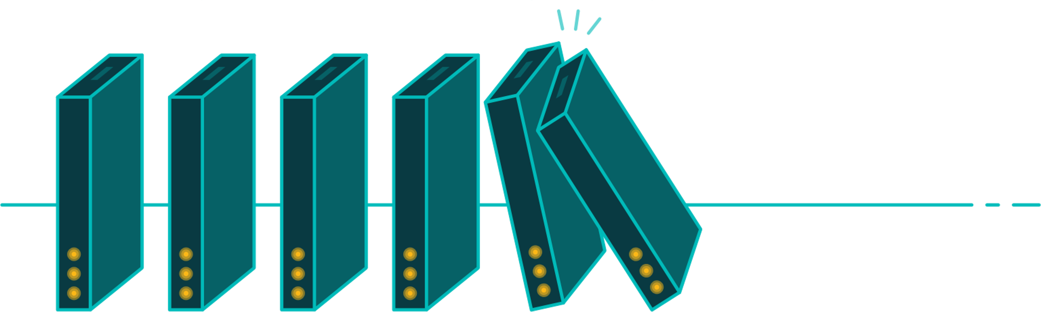
Pros and Cons of Dedicated Load Balancer Machines
PROS
CONS
Simple: We can have a load balancing hardware or a software version
Single Point Of Failure
Hard to Maintain
Easy To Configure
Geo Limited
Low-Medium Cost

Slide 11

Pros and Cons of Dedicated Load Balancer Machines

Slide 12
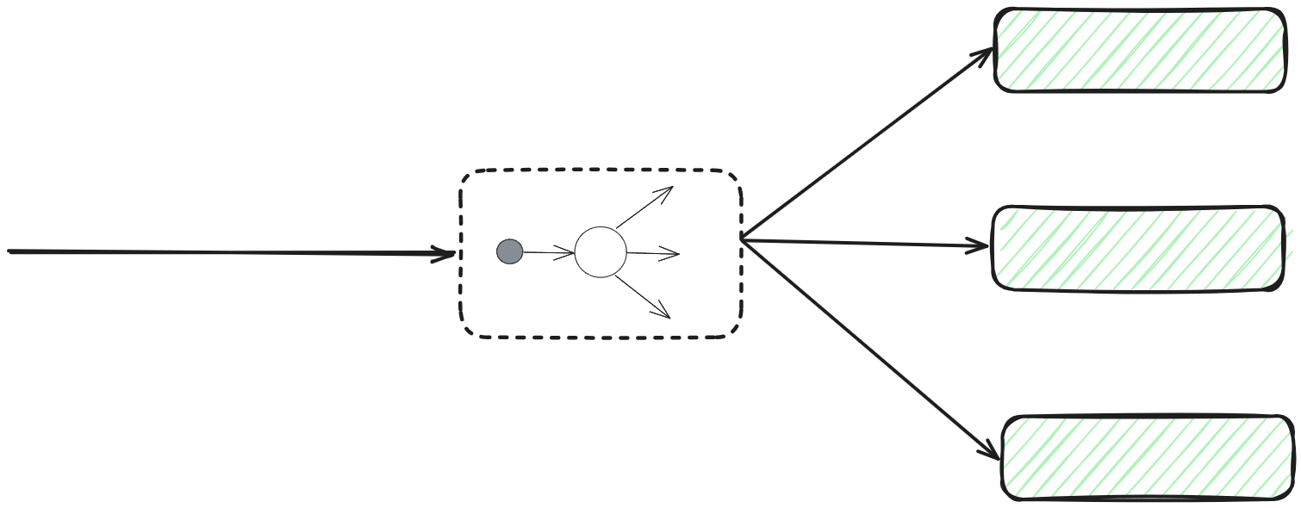
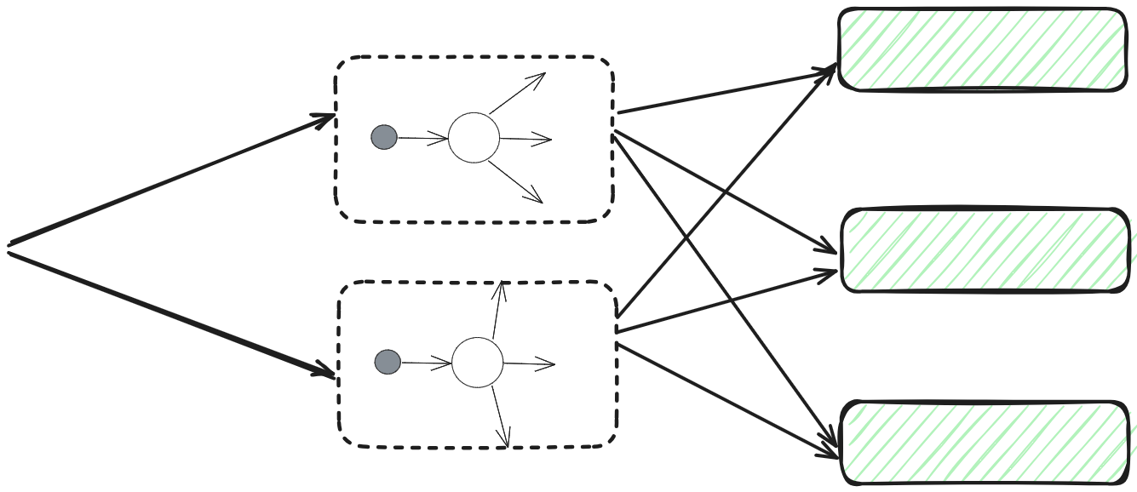
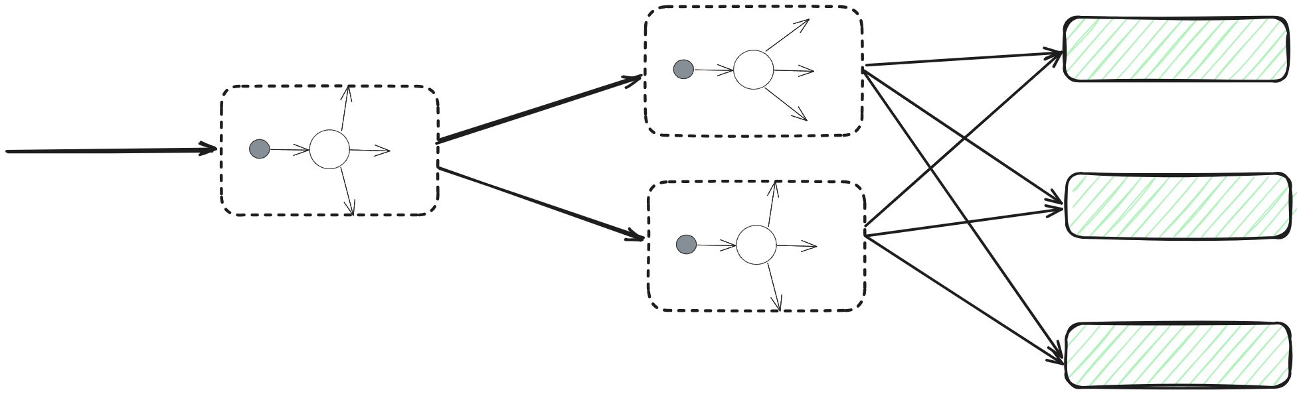
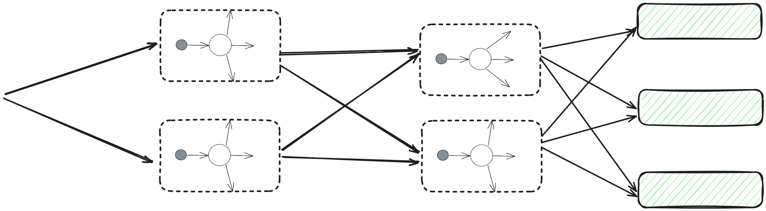
Challenges with Multiple Load Balancers
1
Multiple Load Balancers
What if we have multiple dedicated load balancers?
2
Load Balancing the Load Balancers
How to load balance between load balancers?
3
Scalability Concerns
As the number of load balancers increases, managing them becomes more complex.
4
Next Steps
These challenges led to the development of more advanced load balancing techniques in CDNs.

Slide 13

Challenges with Multiple Load Balancers

Slide 14
Global vs Local Load Balancing
Global Load Balancing
Local Load Balancing
Focuses on directing traffic across geographically distributed data centers to minimize latency and improve user experience.
Manages traffic distribution within a single data center to optimize resource utilization and prevent server overload.

Slide 15
Global vs Local Load Balancing: Key Differences
1
Global Load Balancing
Sending to nearest available datacenter - as measured in round-trip time(RTT) – because we want to minimize the latency on the request
2
Local Load Balancing
Inside of a datacenter, all machines in same building are equally distant to the user and connected to the same network. Therefore the optimal , means optimal resource utilization and protecting a single server from overloading

Slide 16
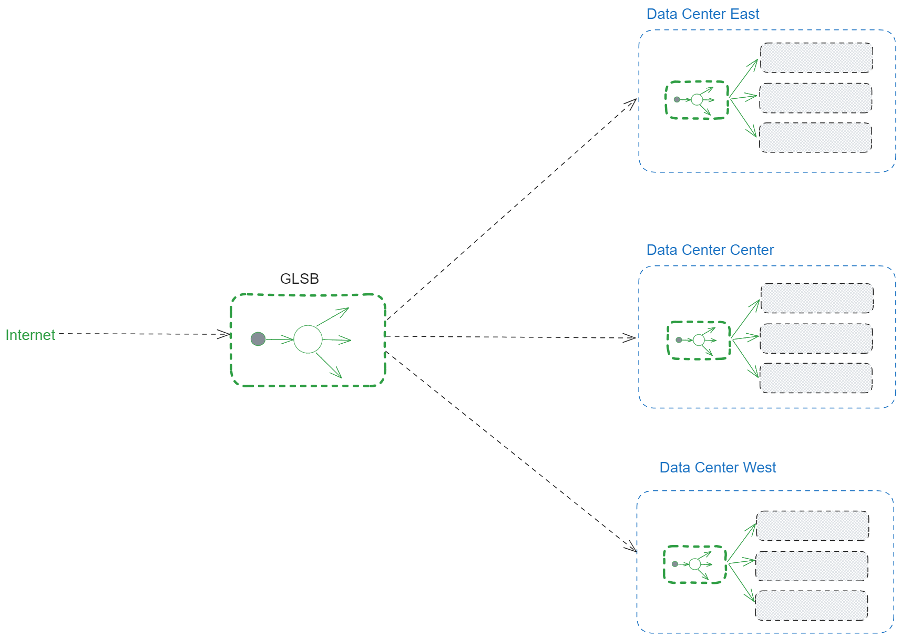
Global vs Local Load Balancing

Slide 17
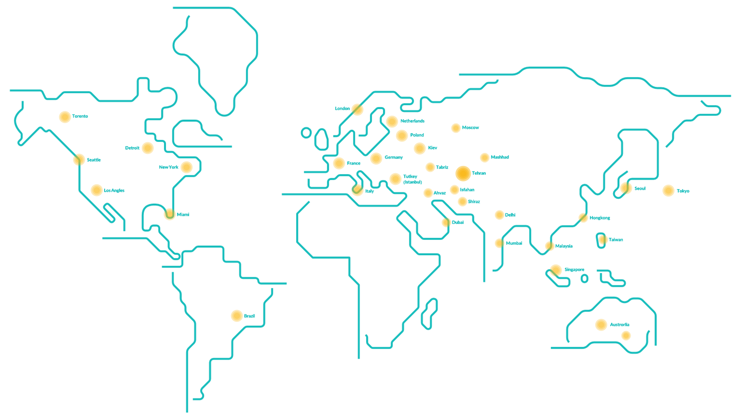
Global Load Balancing in Detail
Geographic Distribution
Latency Reduction
Traffic Management
Utilizes multiple data centers across different regions to serve content closer to users.
Aims to minimize round-trip time (RTT) by routing requests to the nearest available datacenter.
Balances load across global infrastructure to prevent overloading of any single location.

Slide 18
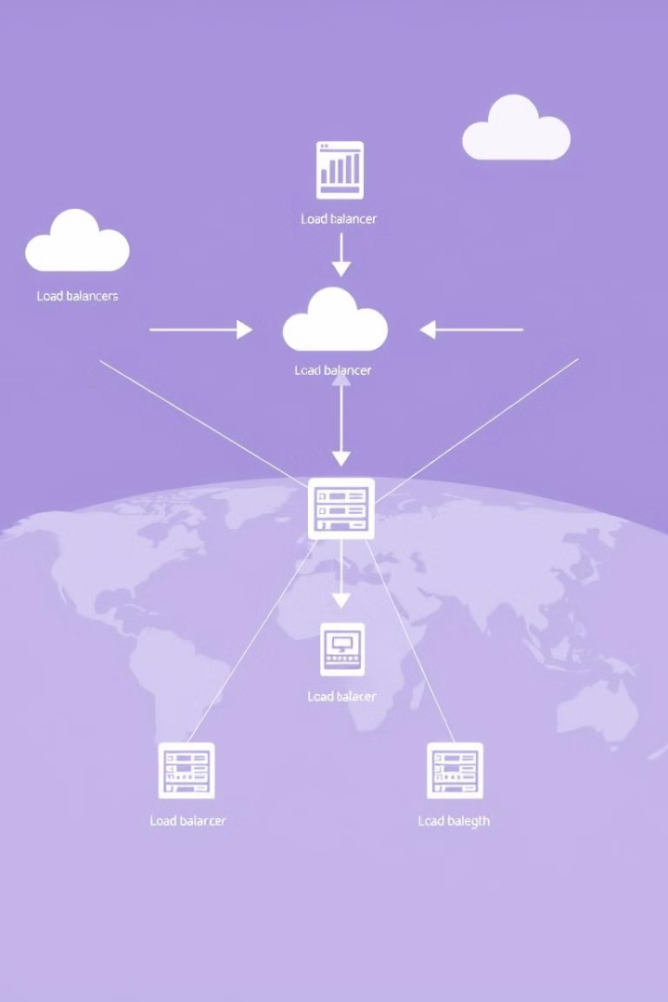
Global Server Load Balancing (GSLB)
1
Distributed Load Balancing
Move the Load balancer to multiple points.
2
DNS-Based Solution
The first solution DNS
3
Challenges
Problems with TTL, Resolvers , attacker target servers…

Slide 19
DNS Based Load Balancing
PROS
CONS
Simple and trivial to implement
Records select randomly, we can use SRV to specify weight and priority but not adopted for HTTP
Return IP addresses As DNS Record
Geo Load Balance Based on source IP address or EDNS
TTL Problem
Very Little Control Over the client behavior, record selected randomly
User Cannot Select Closest Address
DDoS Attacks can Target Specific IP Addresses

Slide 20

DNS Based Load Balancing

Slide 21
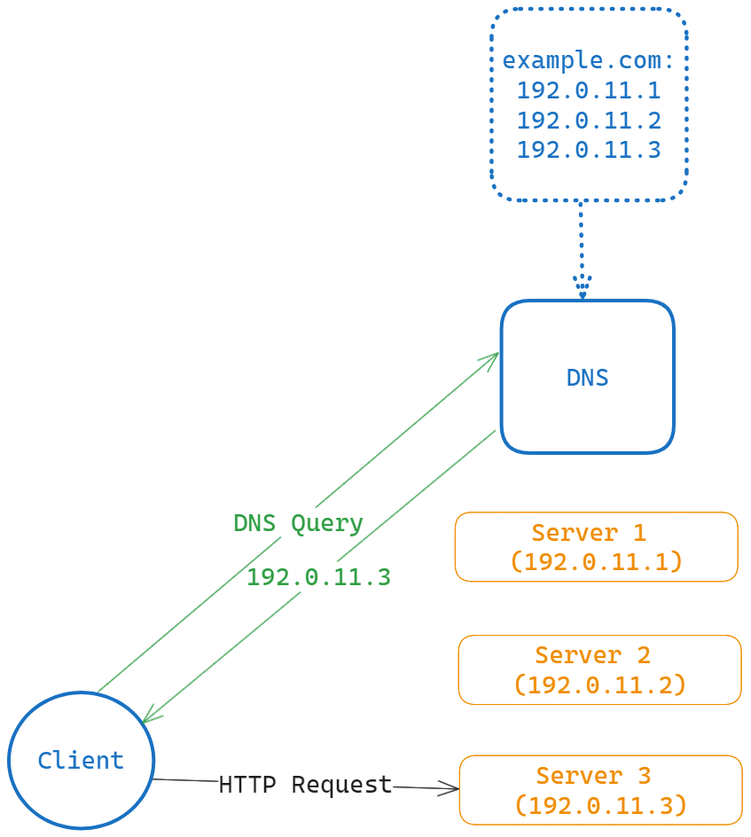




DNS Based Load Balancing Example
Client Request
User initiates a request for a domain
DNS Resolution
DNS server returns multiple IP addresses
Client Selection
Client randomly selects one of the returned IP addresses
Server Connection
Client connects to the selected server

Slide 22

DNS Based Load Balancing: Challenges
1
Recursive DNS Servers
End users rarely talk to authoritative DNS servers directly, instead a recursive DNS server usually lies somewhere between end users and nameservers
2
Resolution Complexity
Recourse resolution of IP Addresses
3
Unpredictable Paths
Nondeterministic reply path
4
Caching Issues
Additional cache complications

Slide 23
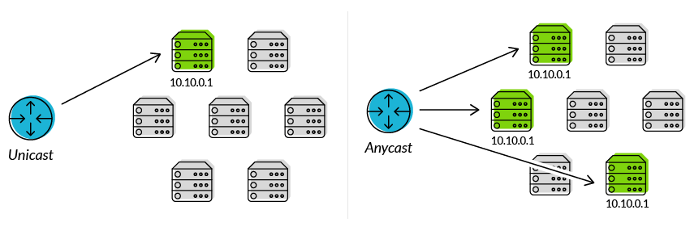
Anycast: A Modern Approach
Anycast Technology
Improved Latency
Utilizes the same IP address across multiple locations, routing traffic to the nearest point of presence.
Reduces round-trip time by automatically selecting the closest server.
DDoS Mitigation
Simplified Configuration
Helps distribute and absorb attack traffic across multiple locations.
Eliminates the need for complex DNS-based load balancing schemes.

Slide 24
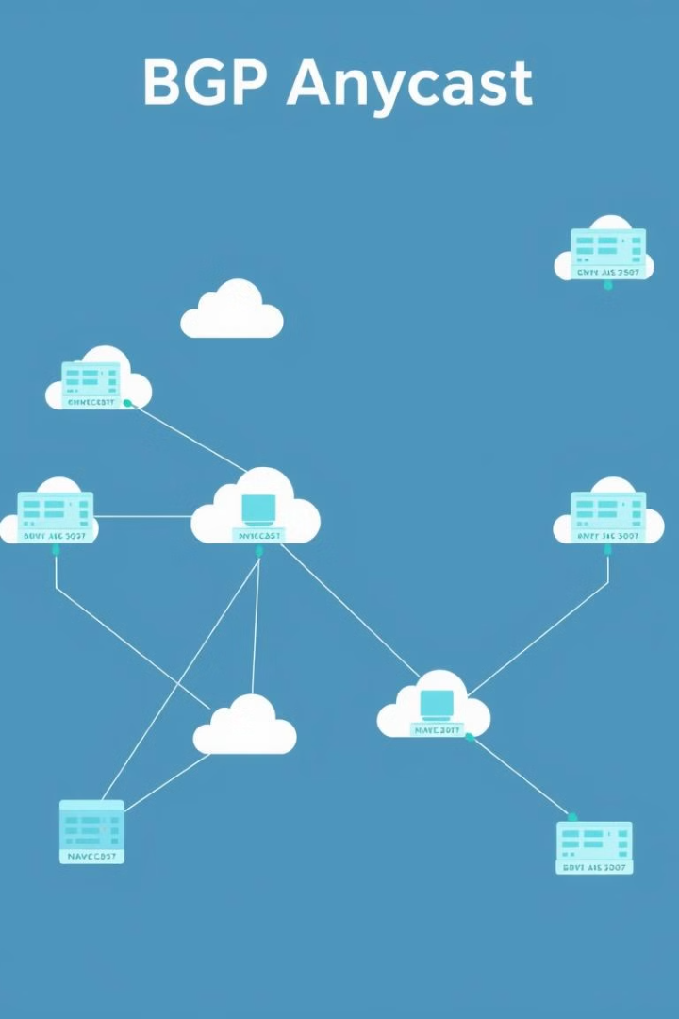
BGP Anycast: Hiding Behind the Same IP
1
Concept
BGP Anycast allows multiple servers to share the same IP address
2
Hiding Technique
Servers effectively "hide" behind a single IP, improving routing efficiency
3
Network Optimization
Enables intelligent traffic routing to the nearest or most optimal server

Slide 25
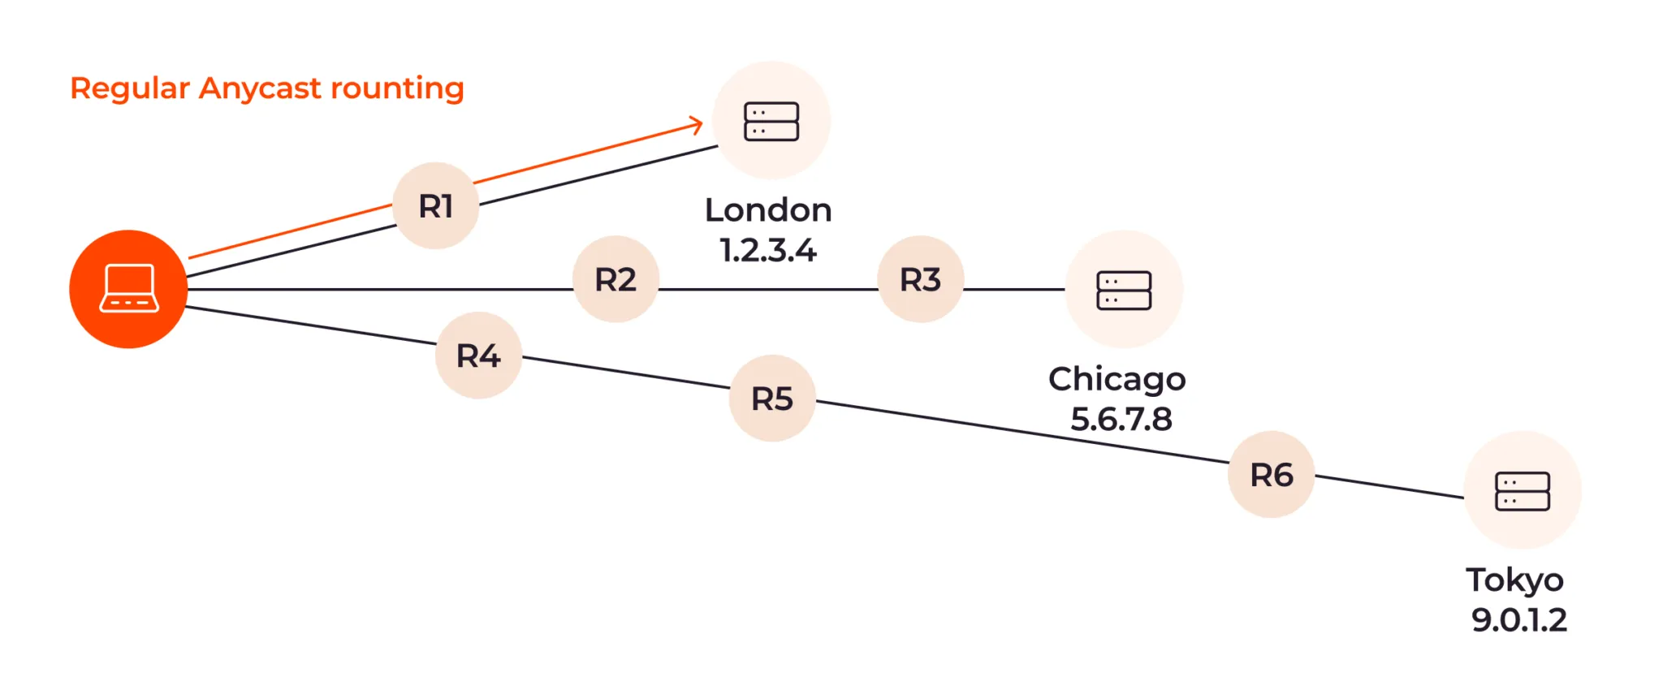
Regular Anycast Routing

Slide 26
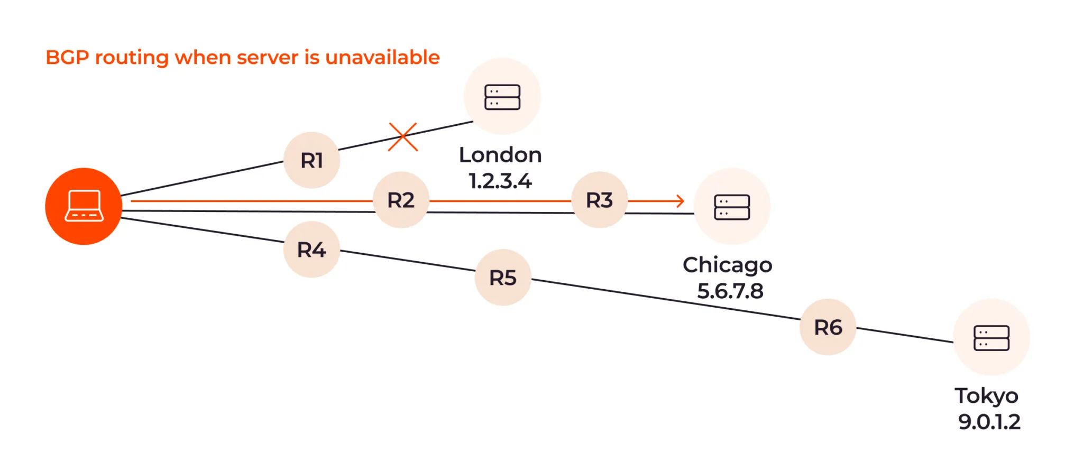
BGP Anycast Routing

Slide 27


Understanding BGP Anycast
1
BGP Advertisement
Multiple servers advertise the same IP address using Border Gateway Protocol (BGP)
2
Routing Decision
Network routers choose the best path to reach the advertised IP based on BGP metrics
3
Traffic Distribution
Incoming requests are automatically directed to the nearest or most optimal server

Slide 28
Benefits of BGP Anycast
Improved Performance
Availability and Redundancy
Load Balancing
Reduces latency by routing traffic to the nearest server
Distributes traffic across multiple servers efficiently
Enhances reliability by providing multiple server options
Scalability
DDoS Protection
Easily add or remove servers without changing the IP address
Improves resilience against distributed denial-of-service attacks

Slide 29





BGP Anycast Implementation
Configure Servers
Set up multiple servers with the same IP address
BGP Configuration
Configure BGP on each server to advertise the shared IP
Network Integration
Integrate with existing network infrastructure
Monitoring and Optimization
Continuously monitor and adjust for optimal performance

Slide 30

Local Load Balancing
1
2
3
4
Incoming Traffic
Load Balancer
Server Processing
Response
Traffic arrives at the data center or point of presence (PoP)
Local load balancing hardware or software distributes requests
Individual servers handle the distributed requests
Processed data is sent back to the user

Slide 31
Local vs Global Load Balancing
Global Load Balancing
Local Load Balancing
PoP and Upstream Balancing
- Balances traffic between multiple data centers worldwide
- Distributes traffic within a single data center
- Manages traffic between PoP sites and upstream providers
- Utilizes BGP Anycast for efficient routing
- Balances load between multiple servers
- Optimizes connectivity and reduces congestion
- Improves overall network performance and redundancy
- Ensures efficient resource utilization
- Enhances overall network performance

Slide 32
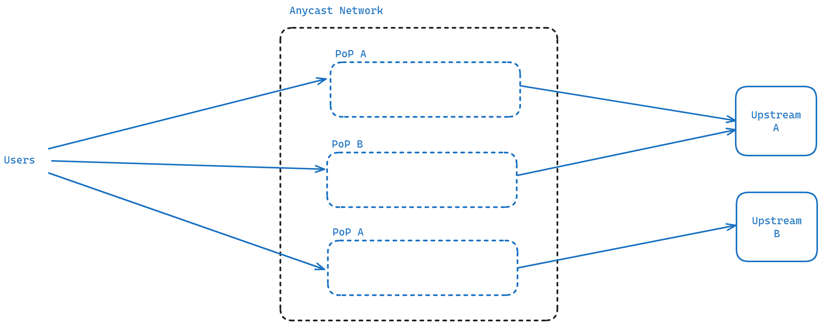
Local vs Global Load Balancing

Slide 33

Comparing Local and Global Load Balancing
Aspect
Local Load Balancing
Global Load Balancing
Scope
Single data center
Multiple data centers
Primary Goal
Server resource optimization
Geographic traffic distribution
Technology
Hardware/software load balancers
BGP Anycast, DNS-based solutions
Latency Impact
Minimal
Significant reduction

Slide 34

PoP Site Level Load Balancer
1
PoP Infrastructure
Each PoP site contains multiple (hundred) servers to handle incoming requests
2
Load Balancer Hardware
Dedicated hardware solutions distribute traffic among servers efficiently
3
ECMP Based Solutions
Equal-Cost Multi-Path routing provides an alternative load balancing method

Slide 35




ECMP Based Solutions
No Weight Setting
Cannot set weight per server, limiting fine-tuned load distribution
Path Variation
Response can go to different server and the send/receive path can be different
Protocol Limitation
It is just based on TCP/UDP, potentially limiting application-layer optimizations

Slide 36
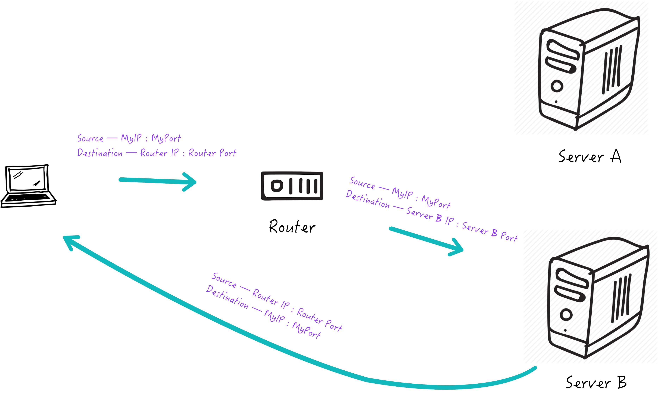
Direct Server Return (DSR)
1
Step 1: SYN Message
The incoming SYN Message goes to Server
2
Step 2: SYN ACK
The server send the SYN ACK to user
3
Step 3: Connection Establishment
The connection stablish between user and server directly
Katran (from META) and Maglev (from Google) are two examples of DSR implementation.

Slide 37

Maglev: Google's Load Balancing System
1
Google's Solution
Maglev is a software-based load balancing system developed by Google.
2
Efficient Distribution
It is designed to distribute network traffic efficiently across many backend servers, ensuring high availability and reliability for Google's large-scale services.
3
Advanced Techniques
Maglev uses consistent hashing and packet-level forwarding to handle millions of requests per second, providing a scalable solution for managing traffic in data centers.

Slide 38
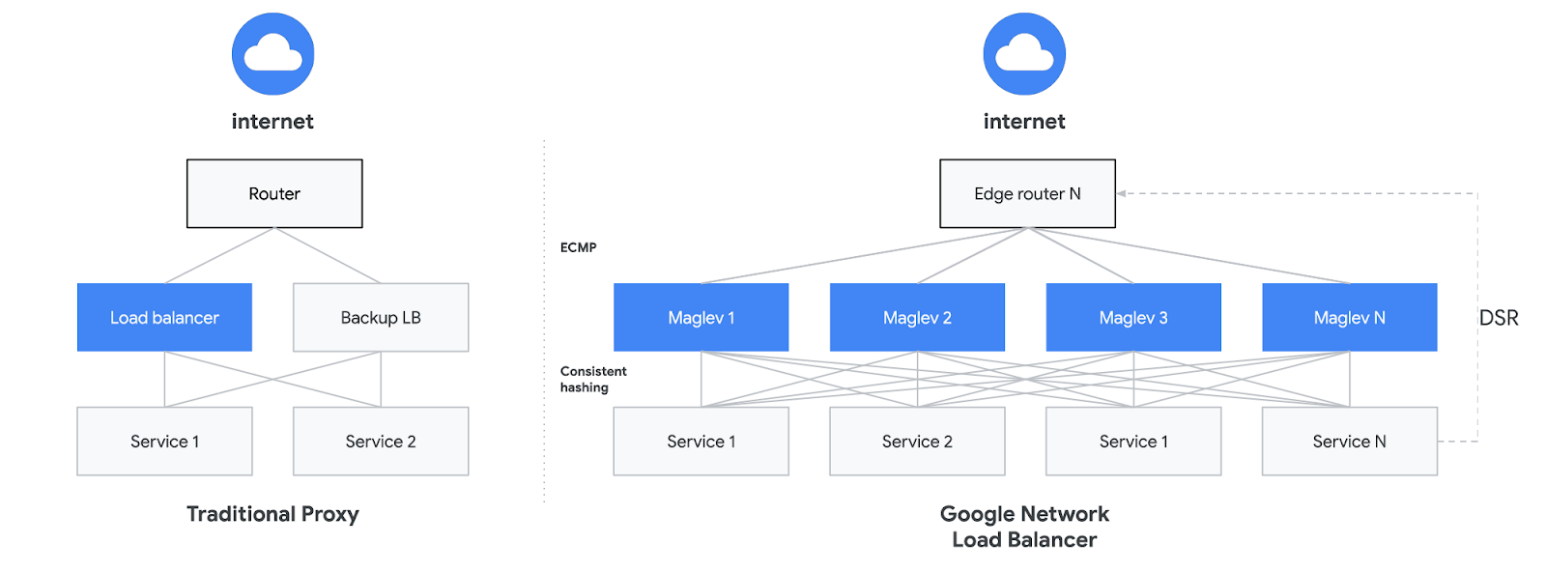
Maglev: Key Components
Packet Processing Engine
Consistent Hashing Module
Health Checking System
Handles incoming network packets and applies load balancing logic
Monitors backend server health and adjusts traffic distribution accordingly
Ensures even distribution of traffic across backend servers

Slide 39



Maglev: Use Cases
Google Search
YouTube
Google Cloud
Ensures fast and reliable search results delivery
Manages high-volume video streaming traffic
Distributes cloud computing workloads efficiently

Slide 40
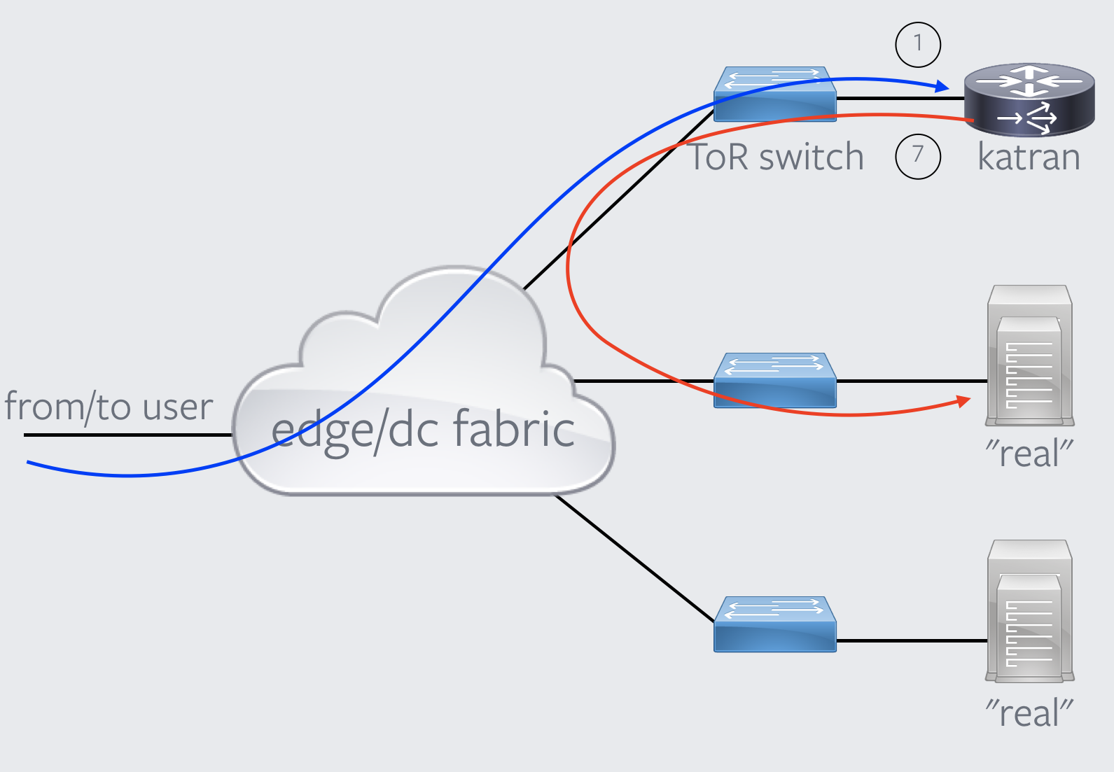
Katran: Facebook's Load Balancing Solution
1
Open-Source Solution
Katran is an open-source, high-performance load balancing library developed by Facebook.
2
XDP-Based Architecture
Built on XDP for efficient traffic distribution across servers.
3
Performance Optimization
It enhances scalability and reliability in large-scale web services by optimizing network packet processing.

Slide 41
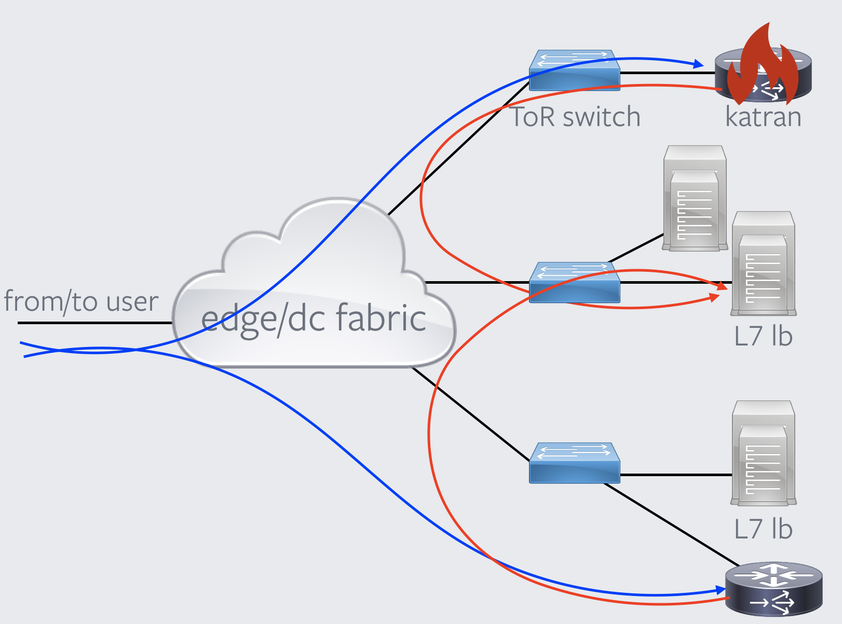




Katran: Key Features
High Performance
Optimized for handling large-scale traffic efficiently
Scalability
Designed to handle growing network demands
Open Source
Freely available for use and modification
XDP Integration
Leverages XDP for efficient packet processing

Slide 42
Katran: Architecture Overview
XDP Layer
BPF Programs
Handles packet processing at the lowest level of the network stack
Implements load balancing logic using eBPF technology
Userspace Control Plane
Consistent Hashing
Manages configuration and monitoring of the load balancer
Ensures efficient distribution of traffic across backend servers

Slide 43


Modifications for Katran
1
Health Check & Monitoring
Implement robust health checking and monitoring systems
2
BPF Layer Firewall & IPv6 Support
Add BPF Layer Firewall and full IPv6 support
3
Maintenance Mode & Central Monitoring
Introduce Maintenance Mode and Central Monitoring System
4
Auto Deploy & Inter-DC Load Balancing
Implement Auto Deploy using Katran and Datacenter-Datacenter Load Balancing
5
Soft-Unicast
Connecting to upstream address using the anycast IP range

